Slide 1

DESIGN THINKING
PHASE 1: FRONTEND DEV PROJECT
TECHBRIDGE COHORT 2022

Slide 2

Prototype
PLANNING IS CHEAP, EXECUTION IS EXPENSIVE

Slide 3
Prototype
A website prototype can be any mock-up or demo of what a website will look like when it goes live. It can be anything from a paper sketch to a clickable HTML prototype. However, typically when people talk about a prototype, they are referring to an interactive prototype of some kind that allows users to navigate from page to page and use functionality such as drop-down menus.
Ref. https://www.experienceux.co.uk/faqs/what-is-a-website-prototype/

Slide 4

Prototype A
WHAT CAN WE DO TO IMPROVE.

Slide 5
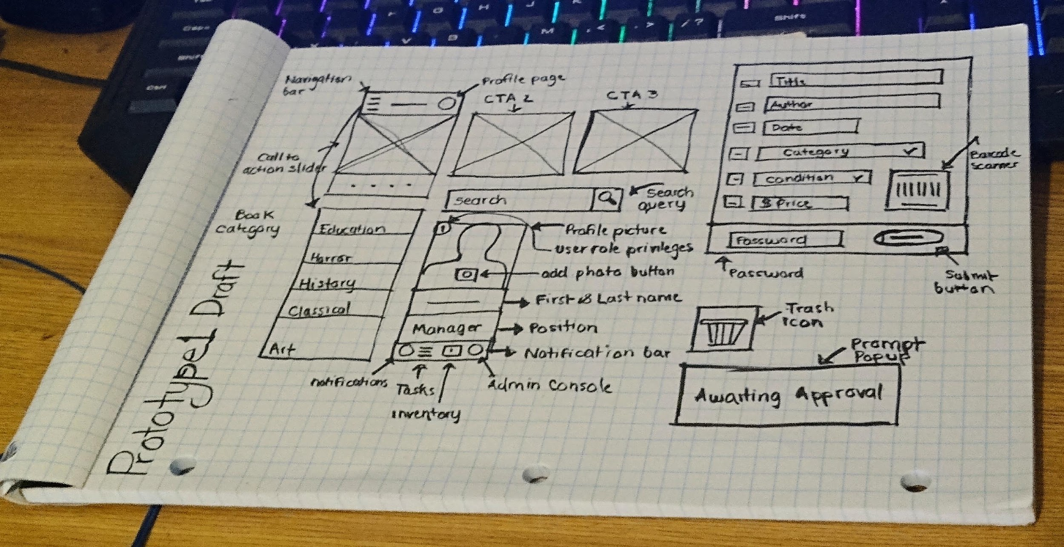

Slide 6
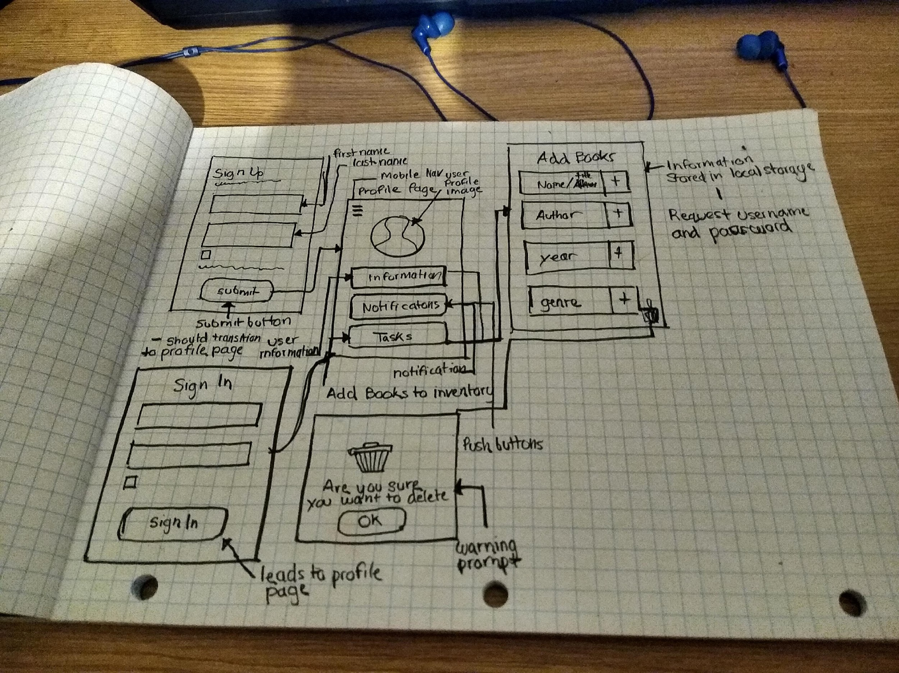

Slide 7

Prototype phase B
It is time to now implement the Html pages
Focusing on what can be accomplished in html.
Prototype should accomplish some of what needs to be achieved.

Slide 8

Prototype B
PLANNING IS CHEAP, EXECUTION IS EXPENSIVE

Slide 9
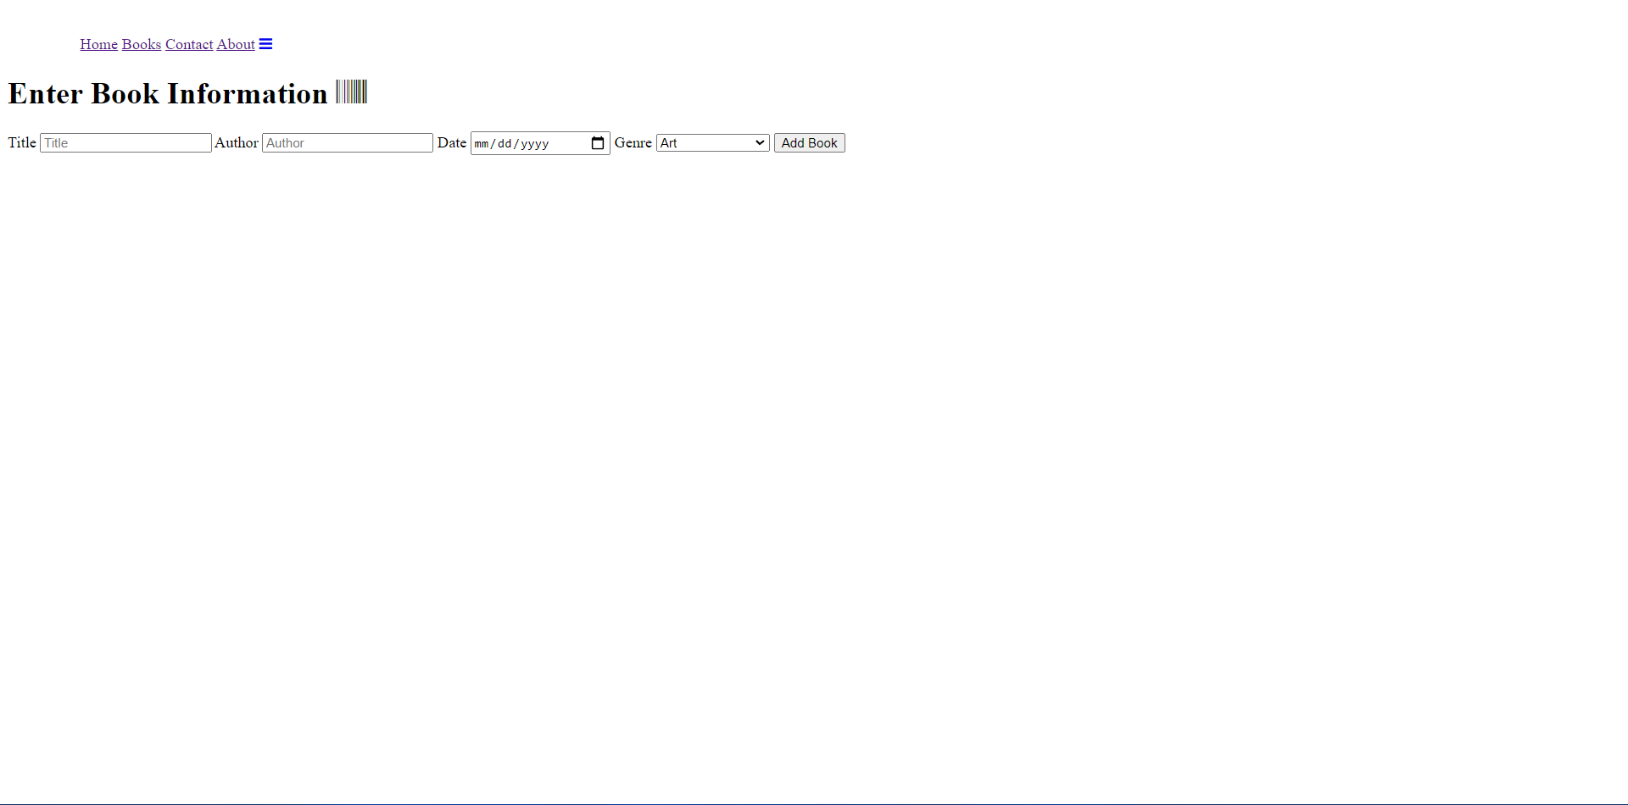

Slide 10


Slide 11
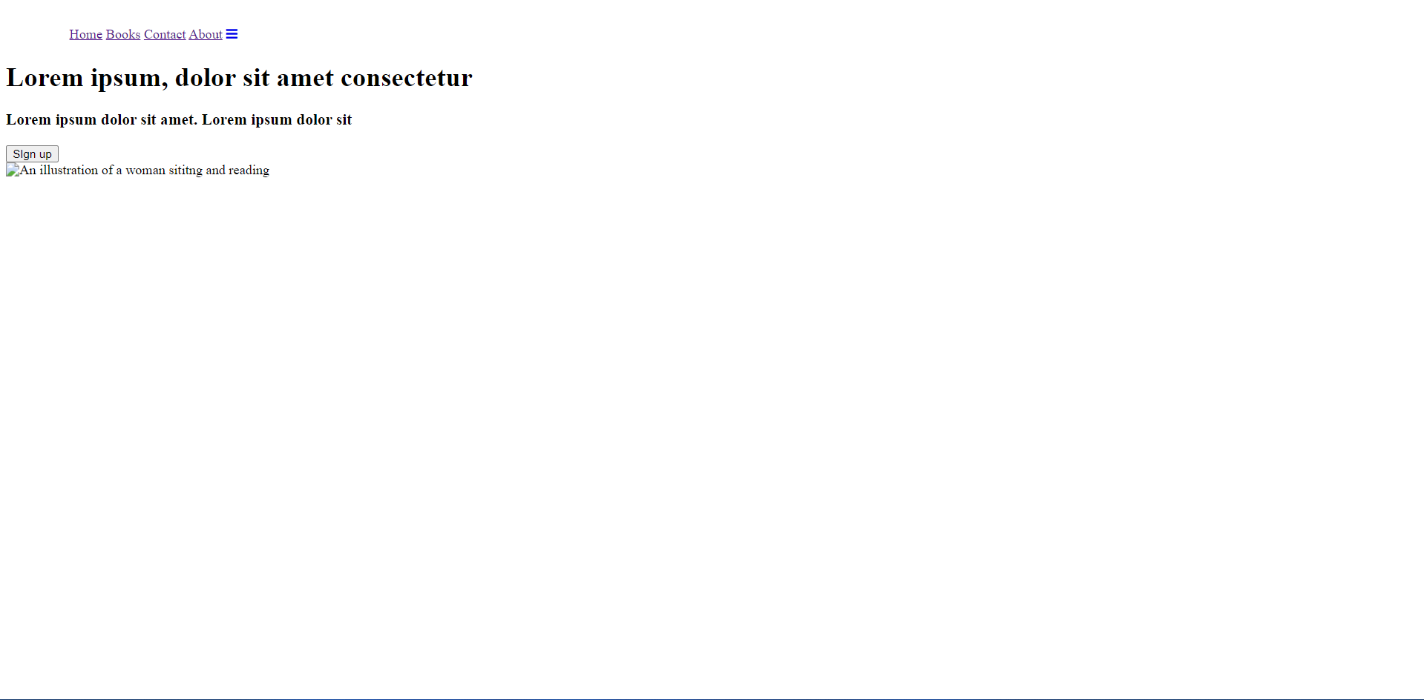

Slide 12


Slide 13
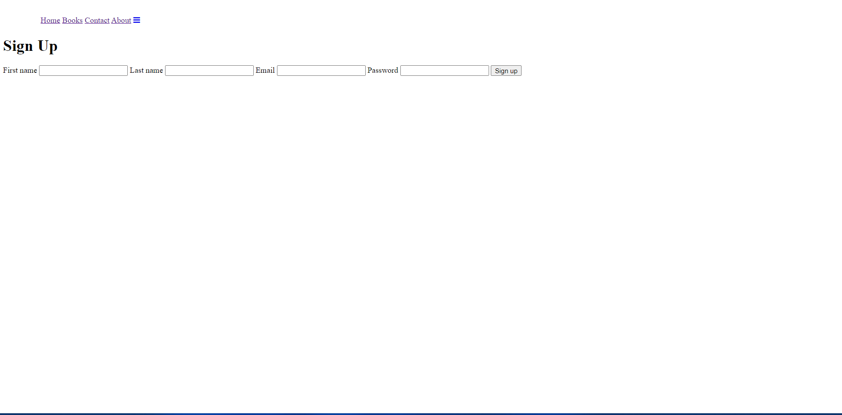

Slide 14

Prototype C
IT’S TIME TO CHANGE THE PACE

Slide 15
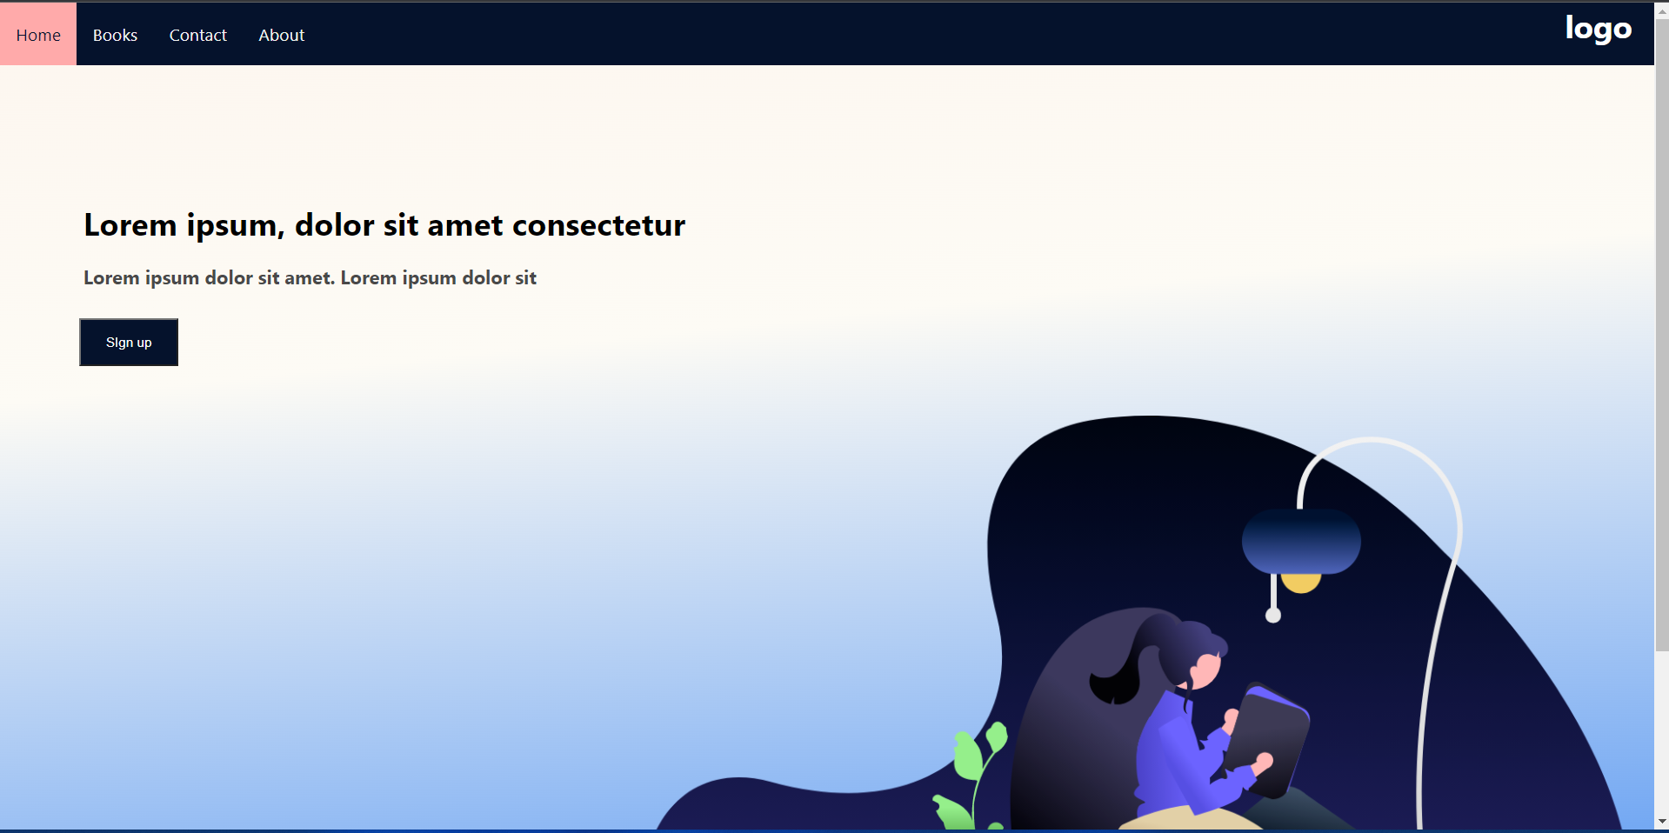

Slide 16
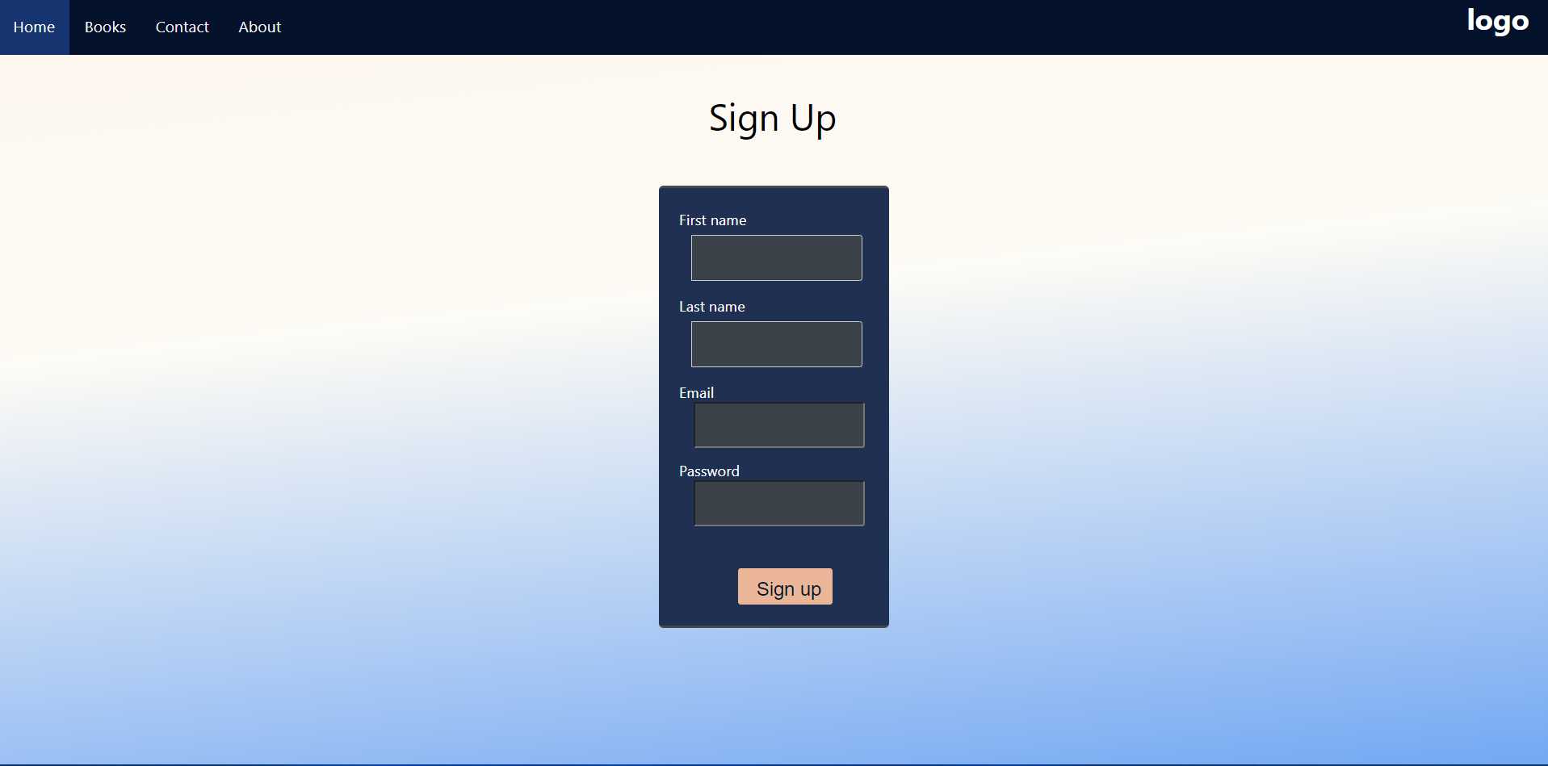

Slide 17
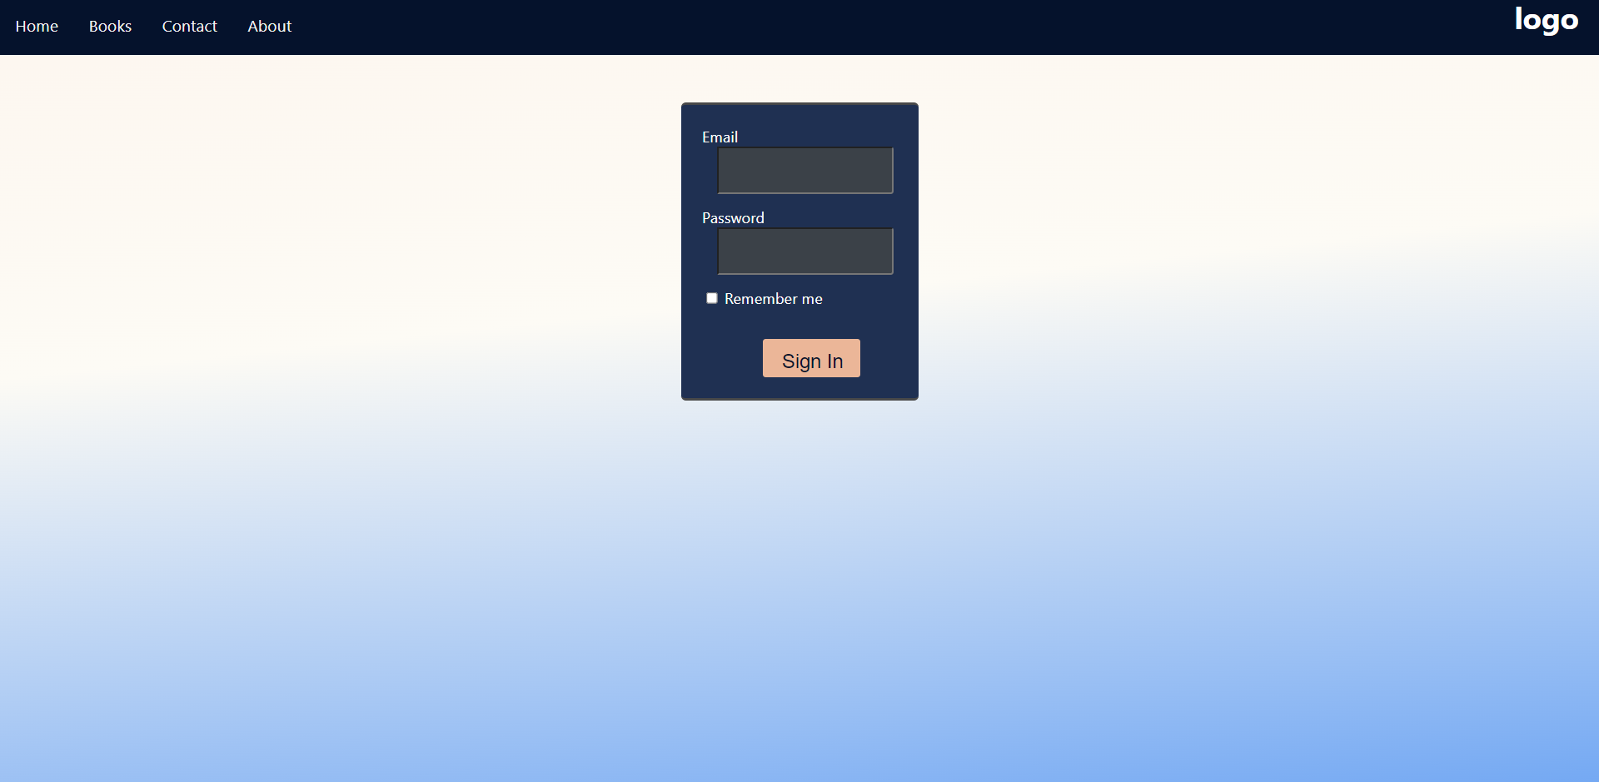

Slide 18
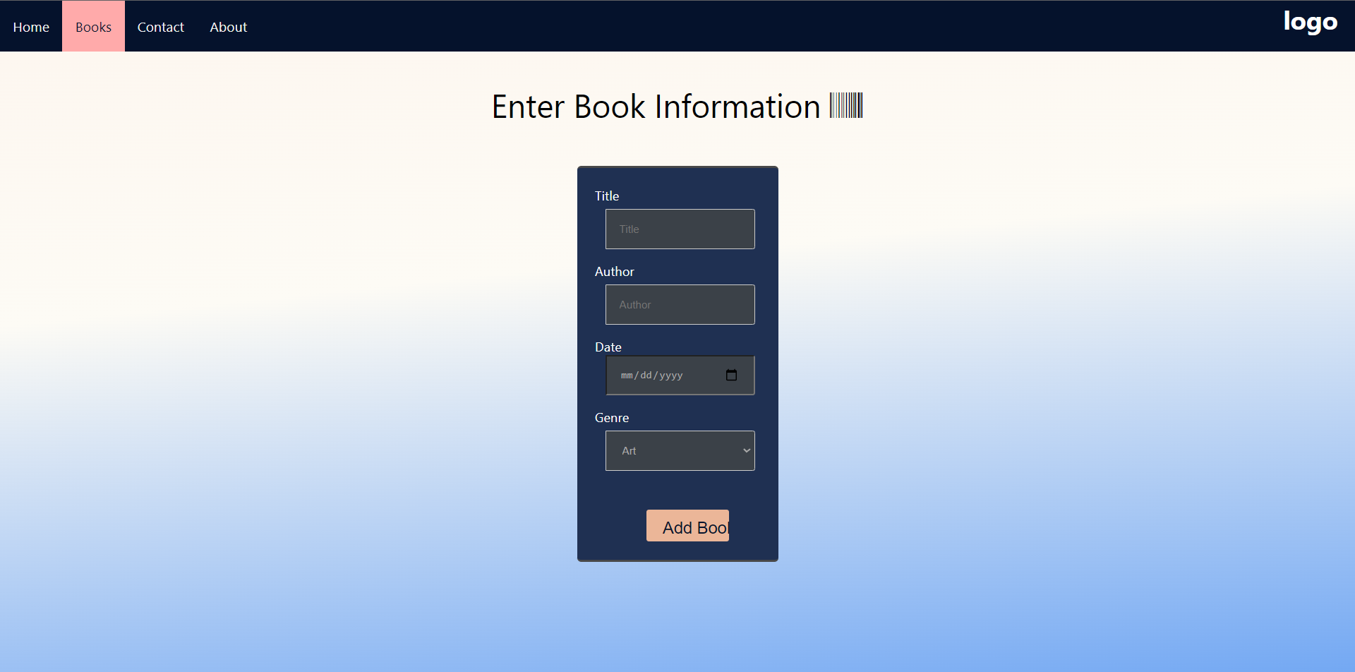

Slide 19


Slide 20
